Slide 1
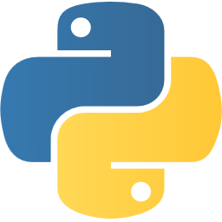
Introduction to Python

Slide 2


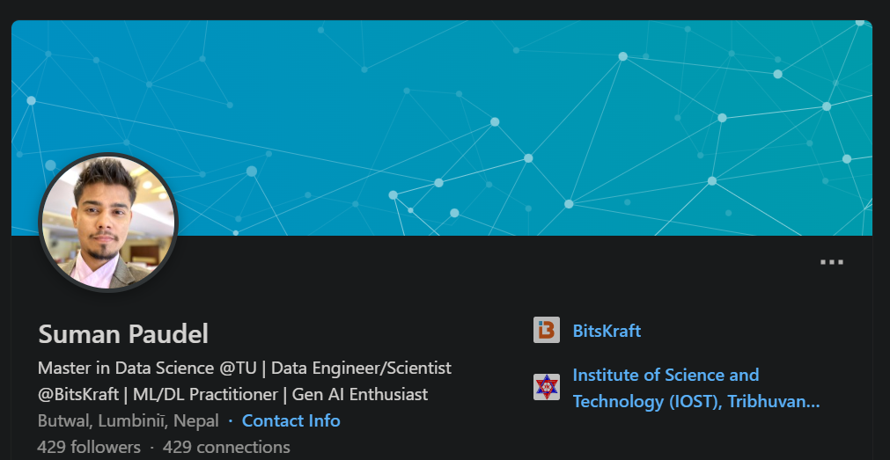
About Me
Data Scientist/Engineer at BitsKraft
Around 2.5 years of industry experience
Contractor as Data Scientist at WiseYak
Graduated Computer Engineering (2021)
Currently Pursuing Master in Data Science at Tribhuvan University
https://www.linkedin.com/in/suman-paudel/

Slide 3
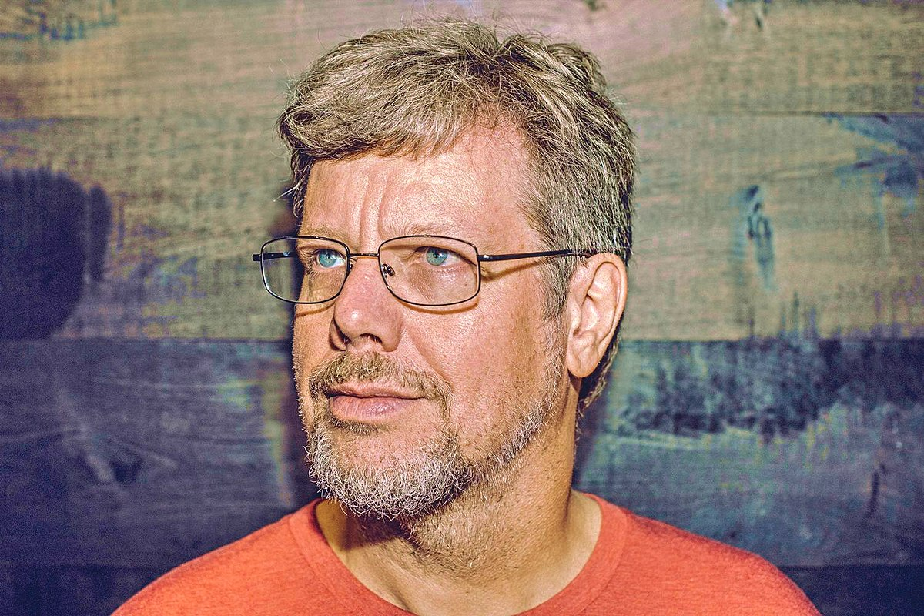
Python
created by Guido van Rossum at 1991.
Easy to learn and powerful programming language.
General purpose programming language with wide range of applications including web development, data analysis, artificial intelligence, scientific computing, and more.
https://www.python.org/

Slide 4
Features of Python
Free and Open Source
Beginner Friendly and easy learning curve6
Easy to Use, Code, Read and Debug
Dynamically Typed and Interpreted Language
Object Oriented Programming Capabilities
Extensive Range of Library and Frameworks
Versatility –wide range of applications.
Strong Community Support and many more…

Slide 5











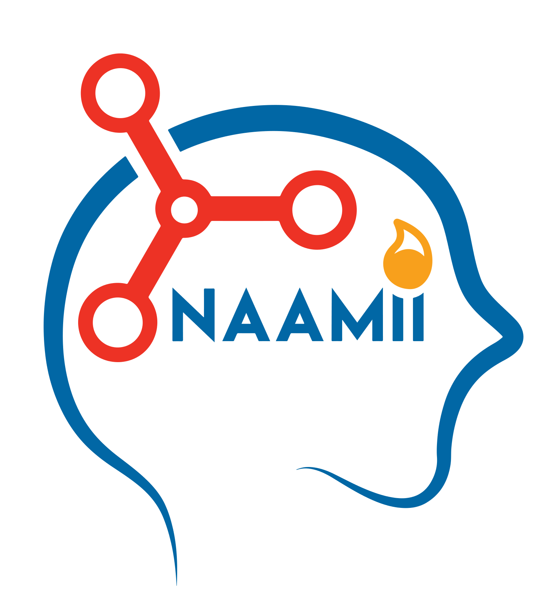
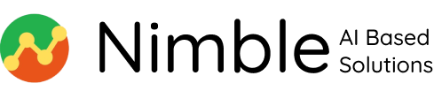






Top IT Companies on Data Science and AI

